Slide 1
Networking fundamentals
Week 2

Slide 2
Introduction to wireless networking
Uses radio waves over specific frequencies to transfer data
Frequency – number of times a specific event occurs in a specified period of time
Page 116-117
1 cycle per second is 1 Hz
1,000 Hz = 1 Kilohertz (KHz)
1,000 KHz = 1 Megahertz (MHz)
1,000 MHz = 1 Gigahertz (GHz)

Slide 3
2,4/5GHz
Both 2,4GHz and 5GHz are unlicensed frequencies
You are able to use them without special permits
The both 2,4 and 5GHz range is split into several channels
5GHz can provide 23 Channels “non-overlapping” 20MHz each

Slide 4
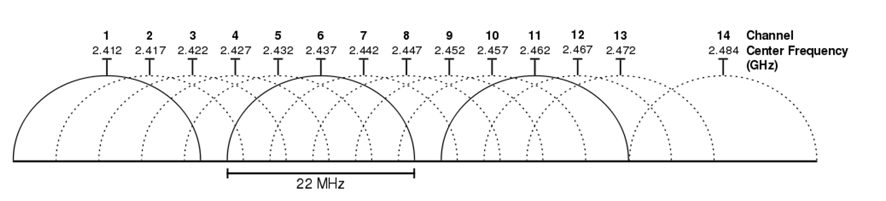
2,4ghz
14 Channels, each 22MHz. Channel Center Frequencies are 5Mhz apart
Because of this, there is a lot of overlapping.

Slide 5
IEEE 802.11 standards
IEEE 802.11 Standard | Data Transfer Rate | Frequency
802.11a | 54Mbps | 5GHz
802.11b | 11Mbps | 2,4GHz
802.11g | 54Mbps | 2,4GHz
802.11n «WiFi 4» | 600Mbps | Both 2,4 and 5GHz
802.11ac «WiFi 5» | 1,3Gbps | 5GHz

Slide 6
Wireless topologies
Ad hoc – basically just peer-to-peer
Devices talk directly to each other without the need for a wireless access point
Infrastructure mode
All communication goes through a wireless access point
May contain one or more WAPs
These WAPs can share the same SSID (Extended Service Set, Mesh)

Slide 7

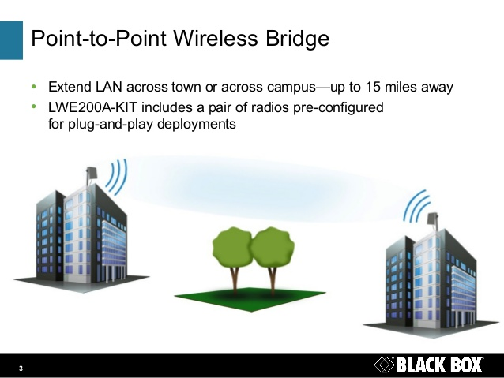
Point-to-point wireless bridge
Up to 15km range
Requires line of sight
Uses unidirectional antennas

Slide 8
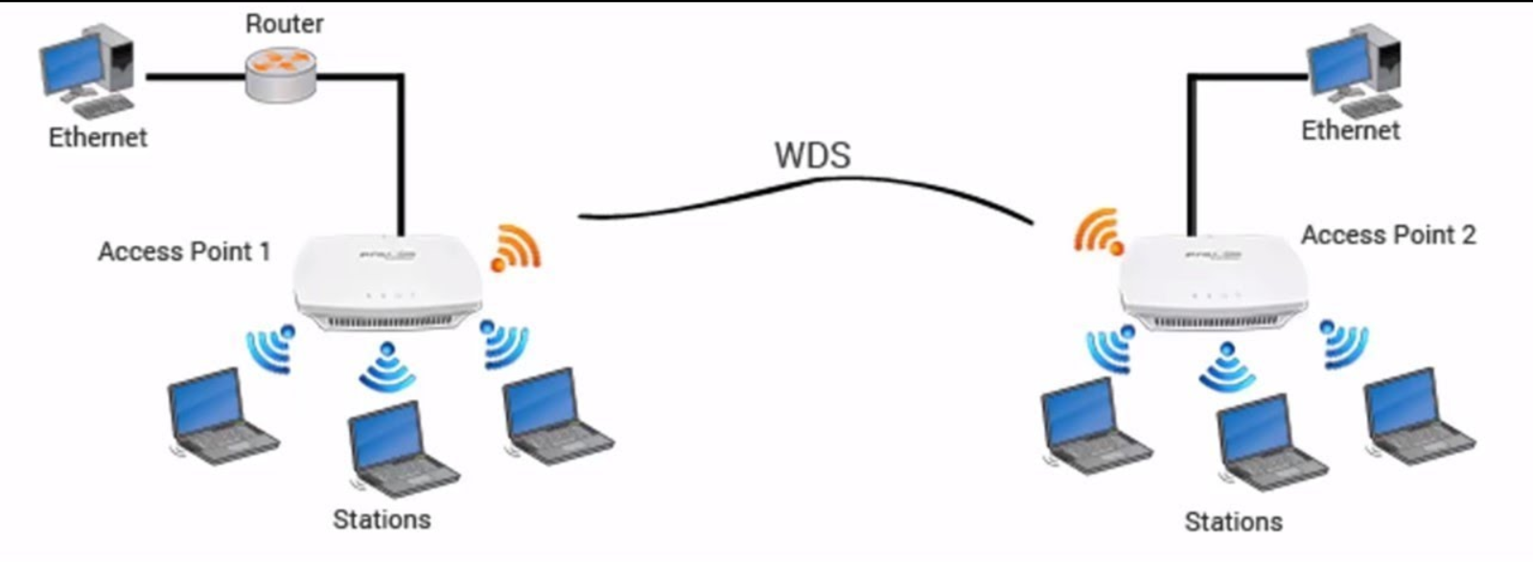
Wireless distribution System
Wireless “Switching”
Main base station – WAP that connects to the wired network.
Remote base station – WAP that accepts connections from clients and relays that information to the main base station.
Must use the same channel

Slide 9
Wireless security
Confidentiality
Integrity
Availability
Protecting data so that only the people who are authorized can see it
Can you trust the data, has it been changed.
Ensures the data is available and ready to be used

Slide 10

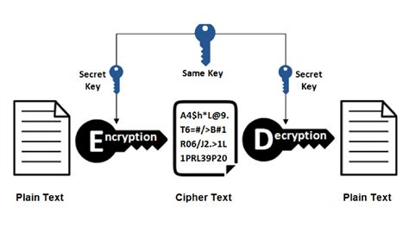
Encryption
Taking readable data (clear text) and putting it through a mathematical calculation (algorithm) to produce data that is not readable (cipher text)
Symmetric encryption uses the same key to encrypt and decrypt.
Asymmetrical encryption uses one key to encrypt, and a different key to decrypt.

Slide 11
Wired equivalent privacy
First form of wireless encryption
Uses a pre-configured password on the WAP to connect.
Very outdated
Do not use
Can be cracked in 30 seconds

Slide 12
Wireless protected access
More secure than WEP
WPA has different versions, WPA, WPA2, WPA3
Usually more secure for each version
Two formats, WPA-Personal and WPA-Enterprise
Personal uses a passphrase similar to WEP
Enterprise uses user credentials

Slide 13
Other wireless security techniques
Disable SSID Broadcast
MAC-Filtering
Disable WPS
Reduce transmission power
Change default username/password
Segment your networks
Scan for rogue WAPs

Slide 14
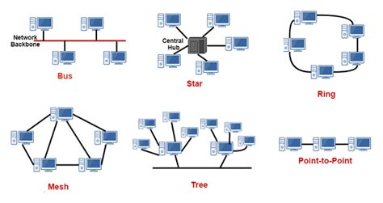
Network topologies
A map of the network
Shows how clients and networking devices are connected together.

Slide 15
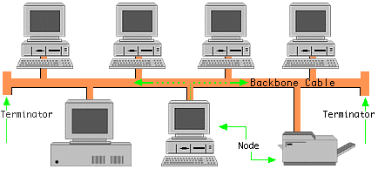
Bus topology
All devices are connected to a backbone cable
The Backbone cable has a terminator in both ends to prevent signals to bounce
Functions like a hub, sends traffic to all devices
Half-Duplex

Slide 16
CSMA/CD
Carrier Sense Multiple Access / Collision detection
Listens if the medium (cable) is idle
Sends traffic if idle, if there is another transmition it sets a random back off timer
If a collision occurs, a jamming signal is sent out, telling all parties to stop sending traffic
All devices then sets a random back off timer before they try to send traffic again

Slide 17
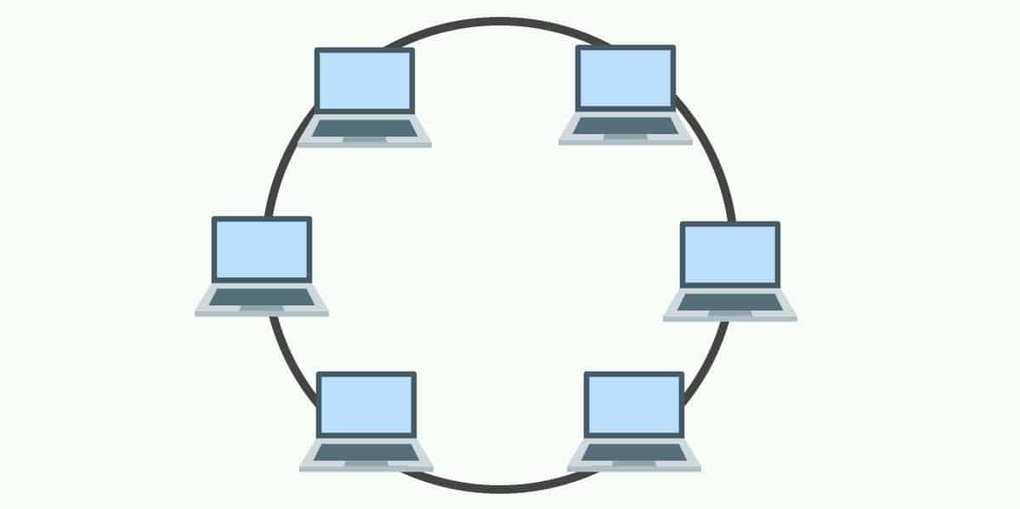
Ring topology
Each devices is connected to two devices.
Easy to troubleshoot, and there are no collisions on the network
Can’t add new devices without breaking up the network

Slide 18
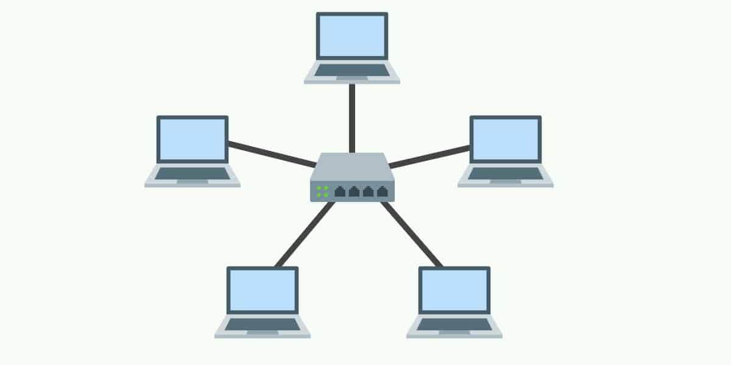
Star topology
All devices are connected to a central point.
Most common topology
Easy to add new devices
If the central devices dies, so does your whole network

Slide 19
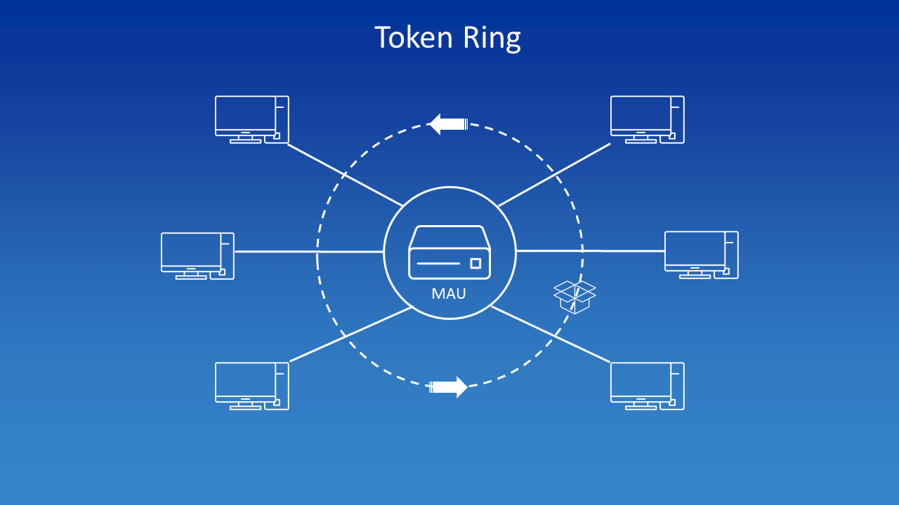
Token ring
Star topology, all devices are connected to central device (MAU)
Media access unit
Devices can only talk when in possession of the token

Slide 20
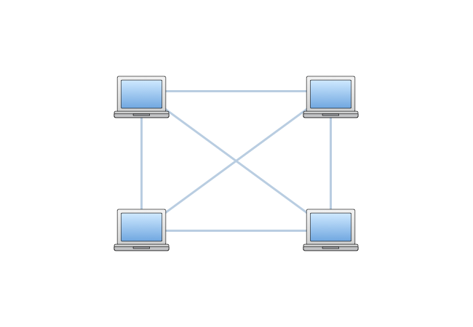
Mesh topology
All devices are connected to every other device
Very redundant/fault tolerant
Requires a lot of interfaces and cables

Slide 21
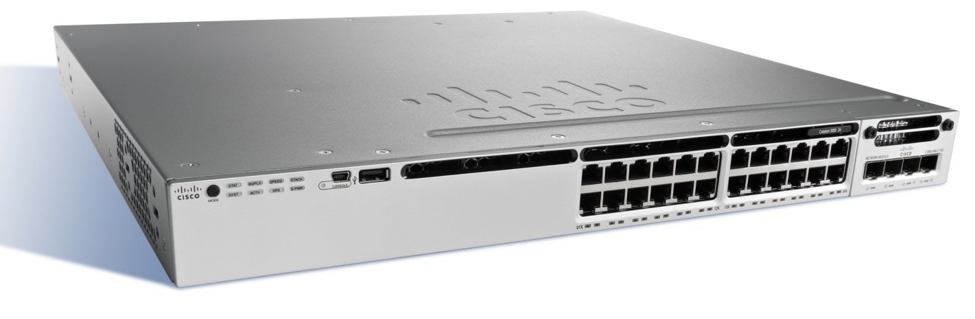
Switches and switching
Forwarding traffic on a Local Network

Slide 22
Switch vs hubs
SWitch
Hub
Breaks up collision domains
Can be managed (change config)
Can store MAC-addresses to make forwarding decisions
1 single collision domain
Sends all traffic out all ports, other than receiving port

Slide 23
Frame forwarding – 2 options
Cut-through switching
Store and forward
As soon as a switch has received the destination MAC address, it starts forwarding the frame
This is very fast, but can cause issue due to not checking for errors
Forwards the frame only after the whole frame has been received, and an error check has been performed
Slower than Cut-through, but often considered better because of the error checking.

Slide 24
Frame forwarding process
When a switch receives data:
It checks to see if the source MAC address is in the MAC table
If it isn’t, the switch updates the table by specifying which interface the sender’s MAC is on
Then it checks the same Table for an entry for the destination MAC
If there is, the frame is forwarded out said interface
If there isn’t, the switch broadcasts the frame from all its interfaces, except the interface that received the frame (Similar to a Hub)
Hopefully the intended recipient will receive the frame and respond
The switch then repeats this process for returning traffic, but now it should know where the source and destination MAC is located

Slide 25
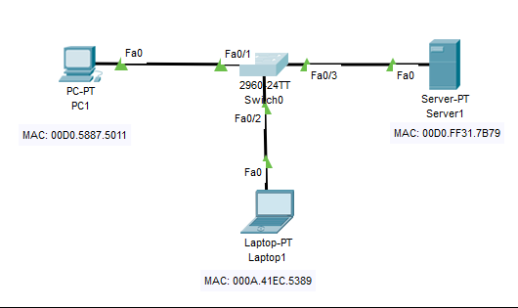
Example: PC1 sends data to server1
PC1 sends data to the switch
The switch receives data and checks MAC table for an entry for PC1 (there is not)
Since no entry, the switch updates the table with the relevant information

Slide 26
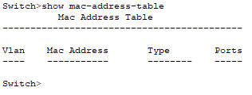
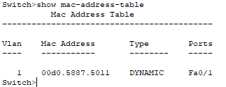
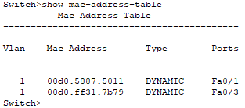
Switch checks MAC table for Destination MAC
Since missing, the frame is being sent out all interfaces (except fa0/1)
Both Laptop1 and Server1 will get the frame, Laptop1 ignores the frame as it’s MAC does not match the destination MAC in the frame
Server1 will process the frame, and send a response
Switch receives frame, checks table for Source MAC
Since no entry in table, switch updates table with Server1’s MAC address
The switch then checks table for an entry for the destination MAC (PC1)
Since this is already in the table, the frame gets forwarded

Slide 27
Summary Frame forwarding process

Slide 28
Spanning tree protocol
STP is used to prevent loops (broadcast storms) when reduntant links are implemented
Switches has this enabled by default
To identify a link being deactivated by STP, look for an orange colour on the port (both IRL and Packet Tracer)

Slide 29
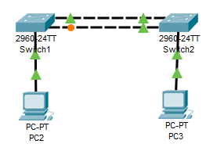
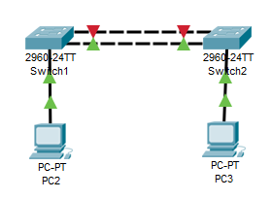
Spanning tree protocol
If one of the redundant links fails, or gets removed, the port blocked by STP will automatically get unblocked
With default settings, this takes 30 seconds.

Slide 30
Managed and unmanaged switches
Unmanaged
Managed
Comes preconfigured with default factory settings, cannot be changed.
Also comes preconfigured, ready to plug and play, but you can do so much more.
On a managed switch you can configure VLANS, port speeds, duplex settings etc.
To change config you often have to connect via console cable with a terminal emulator

Slide 31
Switch ports
Amount
Speeeeeds
Most standard managed switches has either 12, 24 or 48 ports
Unmanaged switches usually has fewer ports
Switch port speeds vary by quite a lot
Fast Ethernet – 10/100 Mbps
Gigabit Ethernet – 10/100/1000 Mbps
Ten Gigabit – 10/100/1000/10000 Mbps

Slide 32
Layer 3 switches
Some switches can also make forwarding decisions based on IP along with MAC addresses, these are called Layer 3 switches
These switches can also route traffic, either by routing protocols or static routes

Slide 33
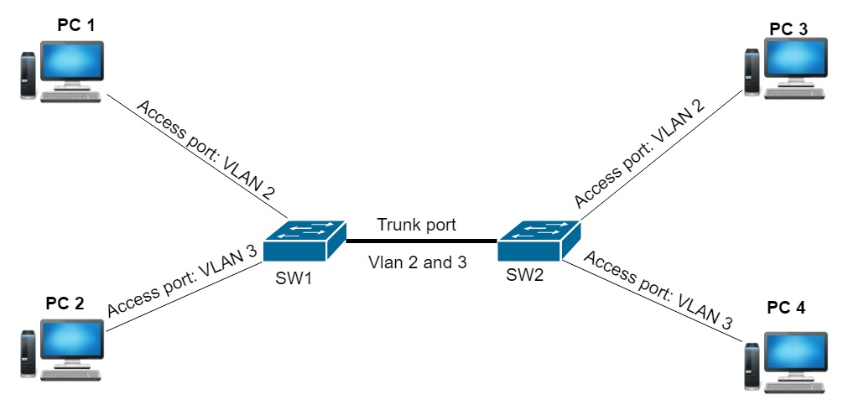
More VLANS
Used to separate networks
Needs a layer 3 switch or router to route traffic between different VLANS
VLAN config is mostly done on switches
You have 2 options for VLAN port settings
Access – Used to assign VLAN to ports
Trunk – Used to allow multiple VLANS to cross the same link.

